Slide 1

Mainfreight Logistics System
By: Sravani Kunapuli
Student ID: 23198431
Presented by Sravani Kunapuli

Slide 2

Why Logistics Systems Matter
Logistics systems connect customers, staff, warehouses, transport teams, and delivery updates.
A delayed or incorrect shipment update can affect customer trust and operational efficiency.
Mainfreight-style systems need clear tracking, staff access control, and department-based workflows.
Problem: Manual or poorly structured systems make shipment updates harder to manage.
Solution: A structured OOP system with GUI, UML models, and design patterns.

Slide 3
Project Problem and Proposed Solution
Original problem from Phase I
Console-based prototype was functional but limited.
Responsibilities needed clearer separation.
Department workflows needed stronger modelling.
Phase I feedback required better role modelling and code-to-design alignment.
Phase II solution
Refined UML models
Windows Forms GUI
Controller-based workflow
Staff/customer/admin access areas
Factory Method pattern
Observer pattern

Slide 4
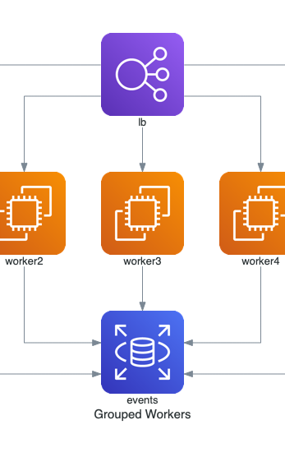
Phase II work completed
Class diagram, sequence diagrams, activity diagrams, state machine diagram
UML Modelling
Inheritance, encapsulation, abstraction, polymorphism
GUI Development
Customer tracking, staff operations, admin access
OOP Implementation
Factory Method and Observer
Design Pattern

Slide 5
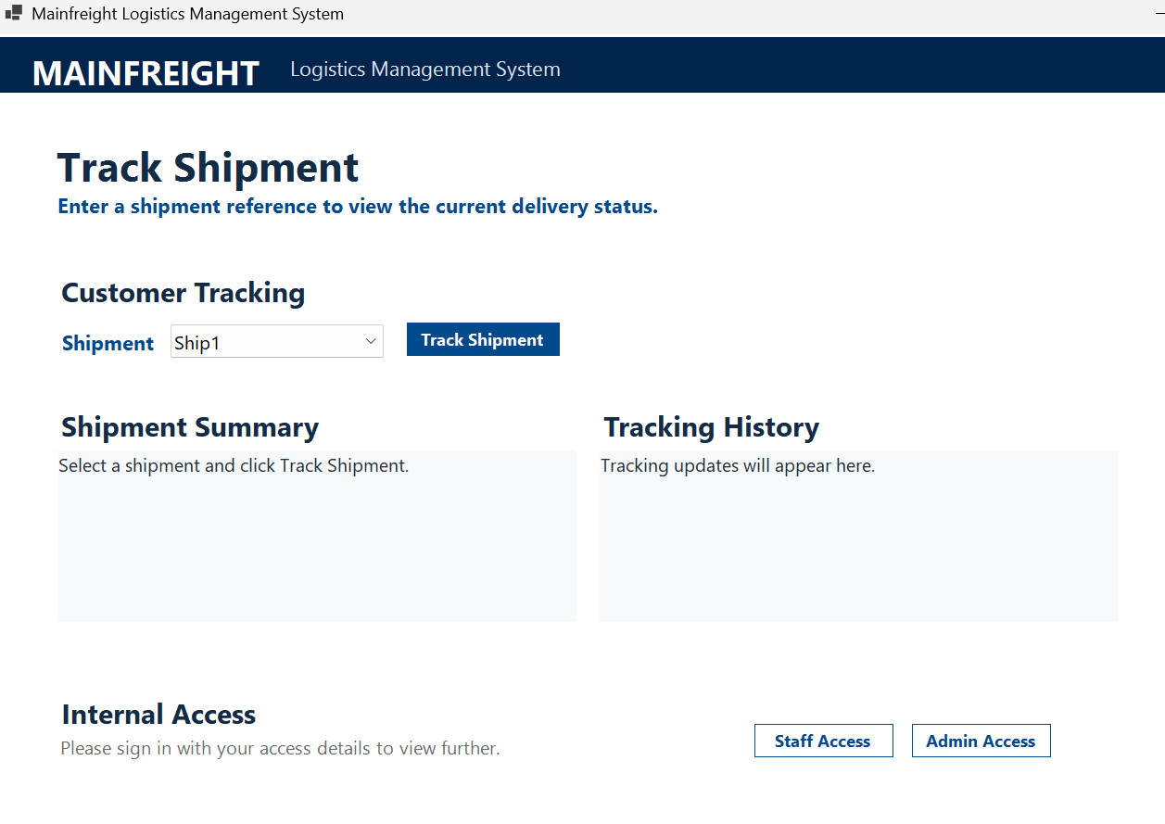
System Overview: How the Solution Works
Customer side:
Customer enters shipment ID
System validates shipment
Shipment details and tracking history are displayed
Staff side:
Staff logs in
Staff searches shipment
Staff updates status or performs department operation
System records update and displays result
Admin side:
Admin logs in
Admin manages staff
Staff list and dropdowns update during runtime

Slide 6
Uml Diagram

Slide 7
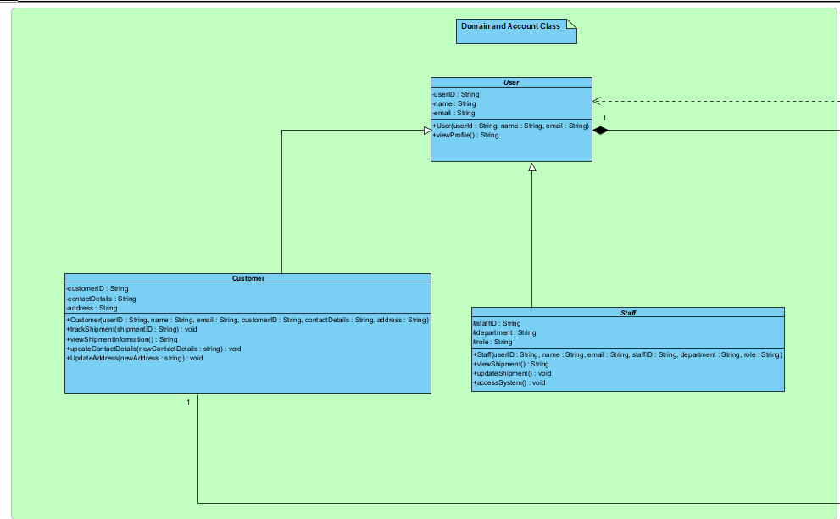
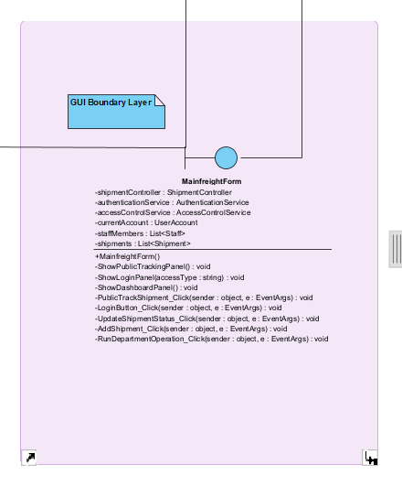

User and Boundary Layer
This layer represents who interacts with the system and how they access the workflows.

Slide 8
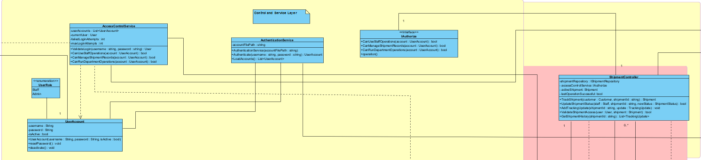
Controller and Service Layer
This layer coordinates system logic and keeps the GUI separate from the backend workflow.

Slide 9
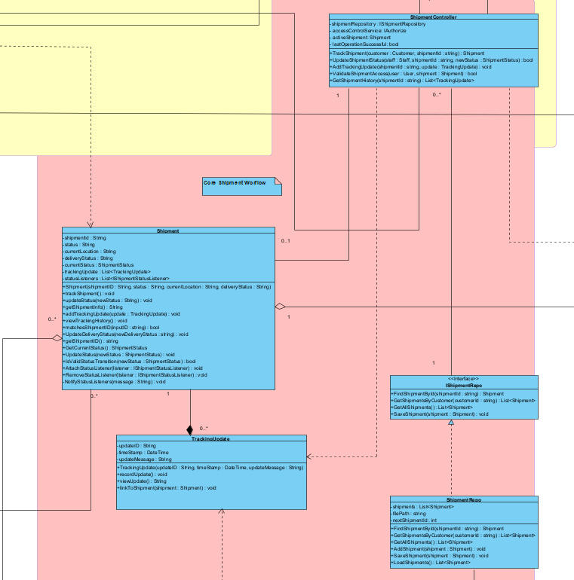
Domain / Entity Layer
This layer stores the main business data and represents the real logistics objects.

Slide 10
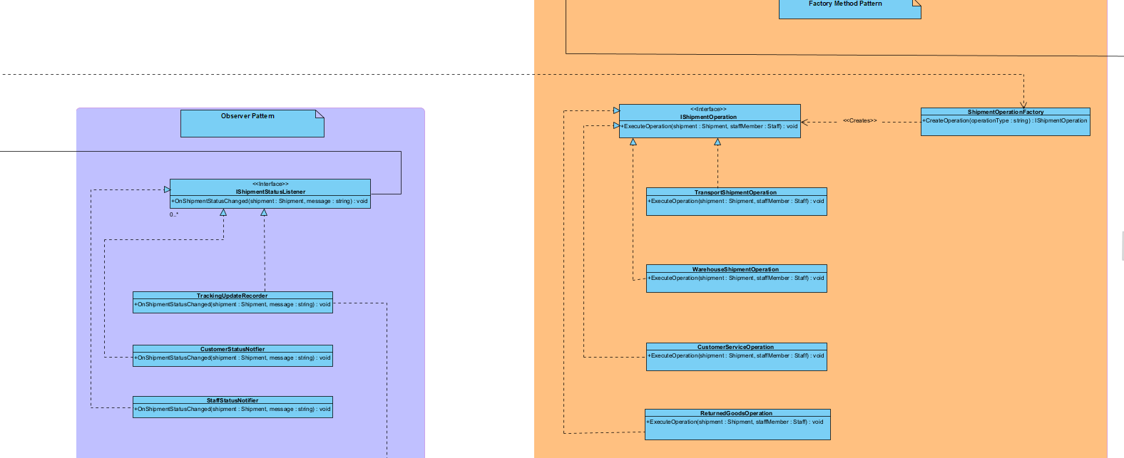
Design Pattern Layer
This layer makes the design easier to extend and maintain.

Slide 11
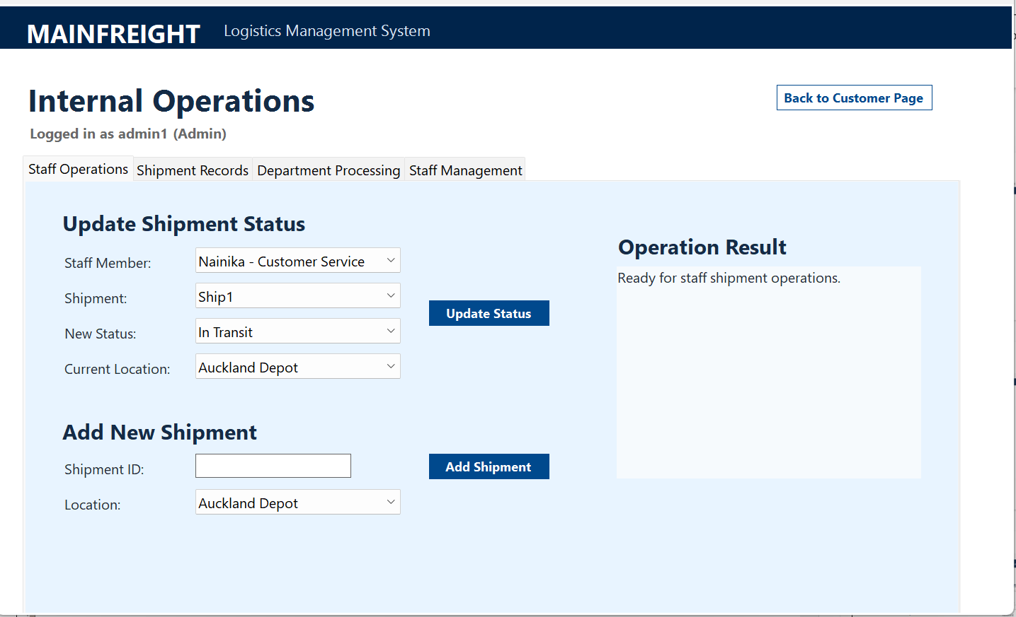
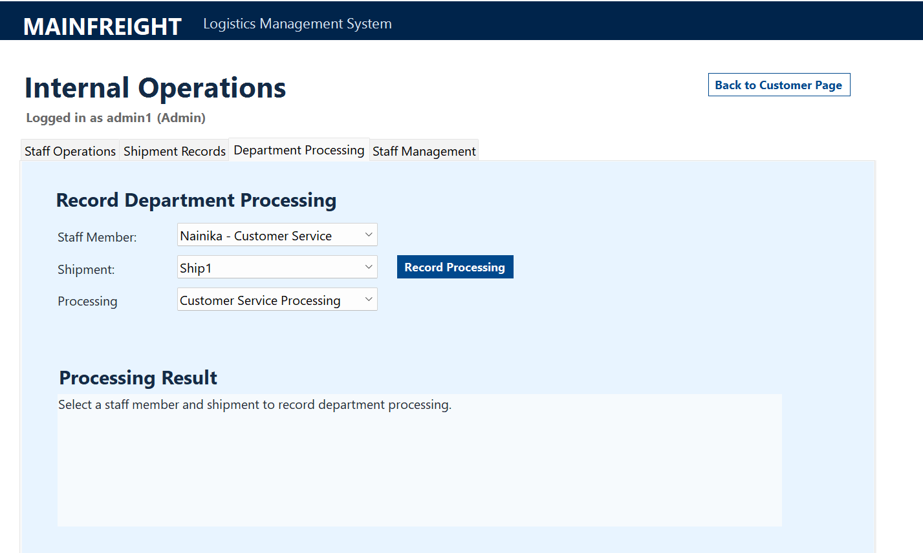
Best Part of the System
The strongest part of the system is how the workflow is separated:
GUI handles user input and display
Controller coordinates the process
Domain classes manage shipment data
Repository handles storage
Patterns handle flexible behaviours

Slide 12
Factory Method: My Design Choice
I used Factory Method because department operations should not be hard-coded into the GUI or controller.
In my system:
Staff selects an operation type
Controller asks the factory for the correct operation
Factory returns an IShipmentOperation
The operation runs through ExecuteOperation()

Slide 13
Observer: My Design Choice
I used Observer because a shipment status change can cause more than one reaction.
In my system:
Shipment status changes
Shipment notifies listeners
Tracking update is recorded
Other staff/customer update behaviours can be added

Slide 14
COnclusion

Slide 15

Q & A
Let’s discuss questions
as a team.

Slide 16
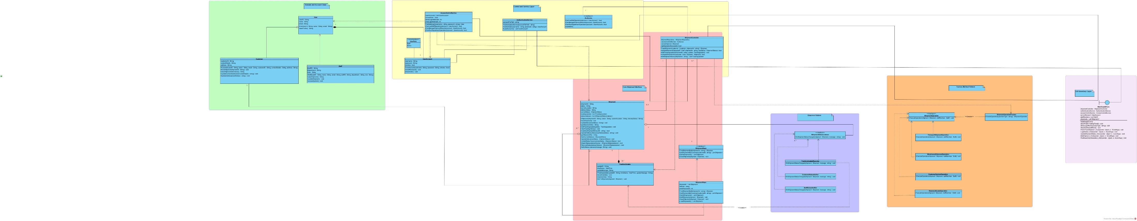
Quote

Slide 17
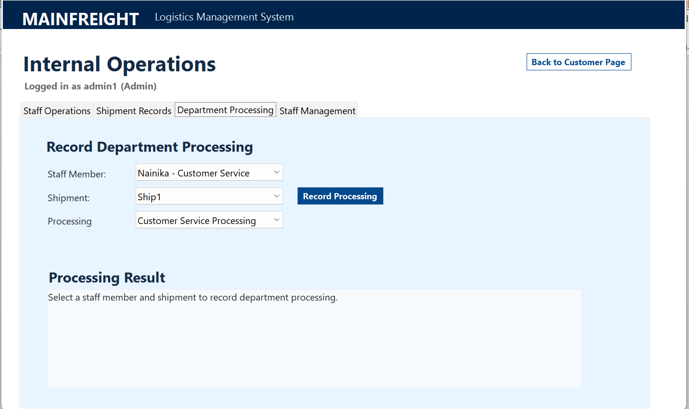
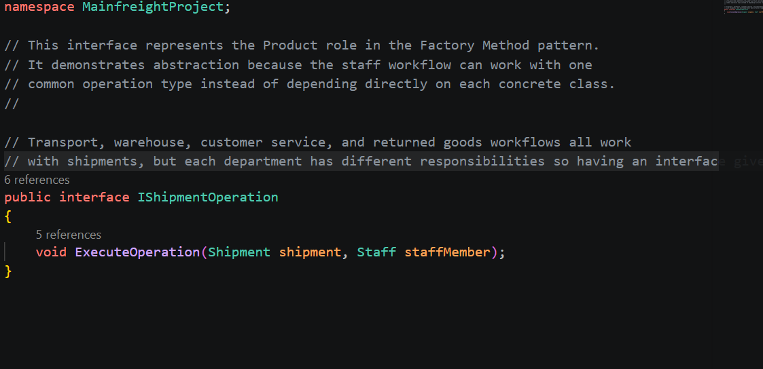
Factory Methods

Slide 18
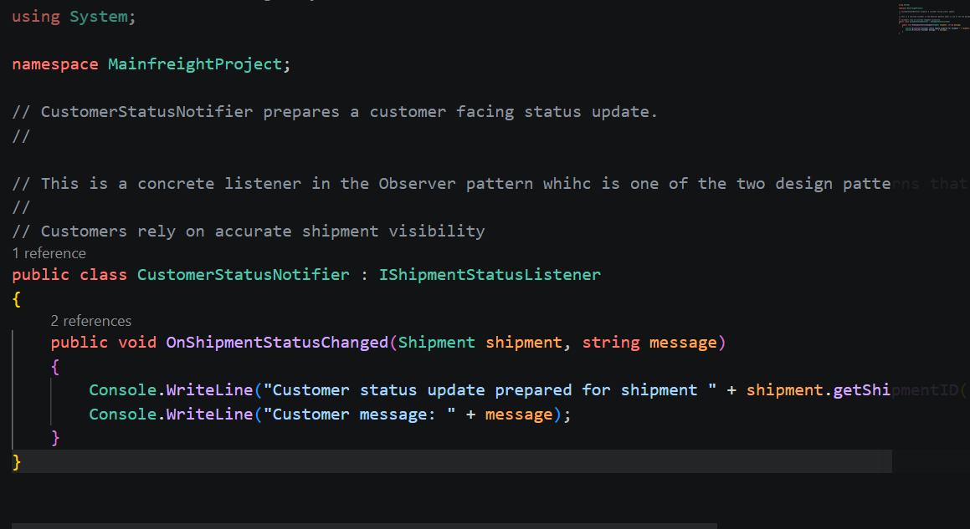
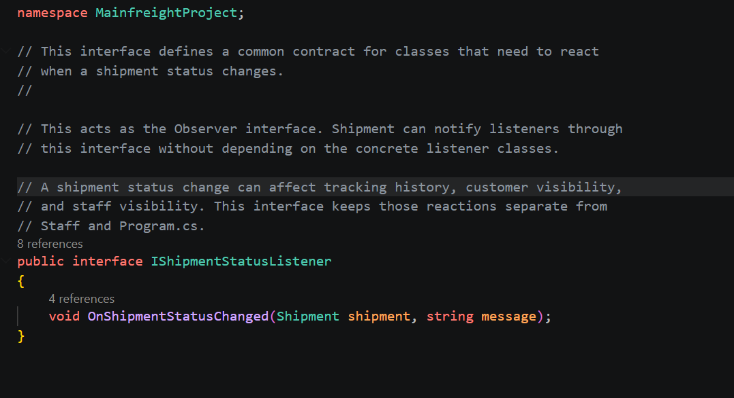
Observer Pattern

